Slide 1

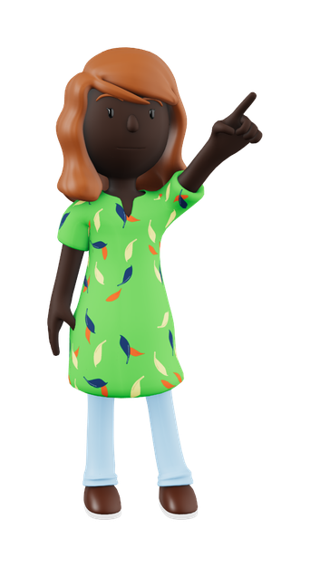

Punctuation Rules
Commas, Semicolons, Colons

Slide 2
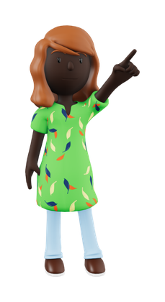



Let’s Review
The usage of commas, semicolons, and colons in sentence writing is very important!
We will look at the incorrect and correct way to use these punctuation marks in sentences.

Slide 3
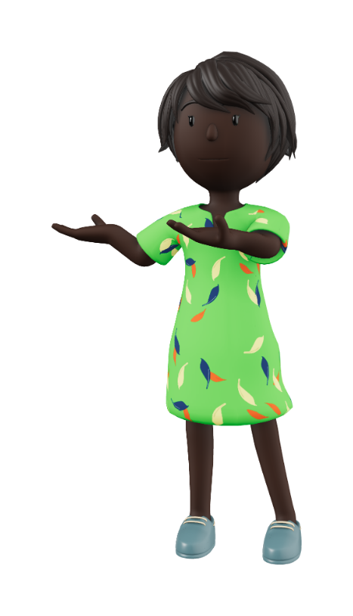
Commas
Do Use Commas:
To join independent and dependent clauses
To separate items in a list
To separate non- restrictive clauses from the rest of the sentence
Don’t Use Commas:
To join independents clauses without using a co-ordinating conjunction (FANBOYS)
To separate a subject and its verb

Slide 4
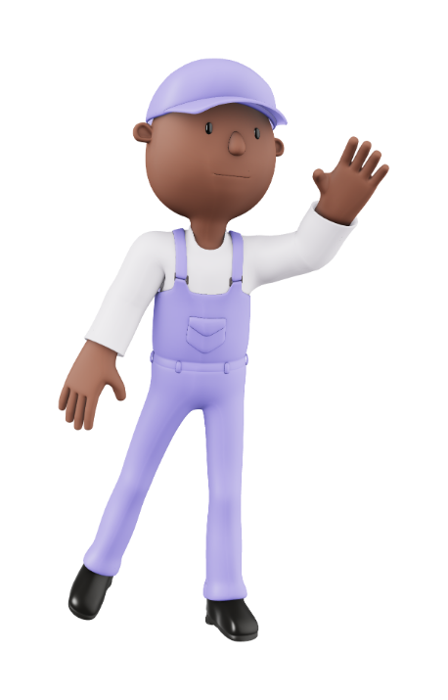
Commas & Clauses
Incorrect:
Go to the store to get milk, don’t forget to take money.
Correct:
Go to the store to get milk, and don’t forget to take money.

Slide 5


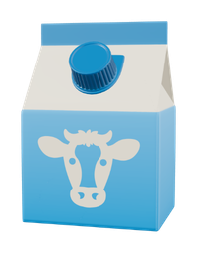
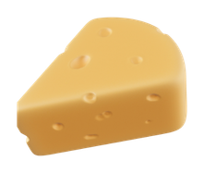
Commas & Lists
Incorrect:
I bought bread, milk and cheese from the grocery store yesterday.
Correct:
I bought bread, milk, and cheese from the grocery store yesterday.

Slide 6

Semicolons
Do Use Semicolons:
To join together independent clauses
To separate items in a list that already include commas
Don’t Use Semicolons:
To join an independent clause with a dependent clause
After a dependent clause

Slide 7
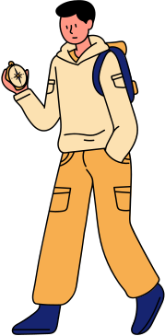
Semicolons & Clauses
Incorrect:
George loves to use his compass when he travels, he has been to Italy, Spain, and Germany,
Correct:
George loves to use his compass when he travels; he has been to Italy, Spain, and Germany.

Slide 8

Semicolons & Commas
Incorrect:
Today I met Linda, a parent, Alex, a teacher, and Ali, a student.
Correct:
Today I met Linda, who is a parent; Alex, who is a teacher; and Ali, who is a student.

Slide 9

Colons
Do Use Colons:
To join together related independent clauses
To introduce items in a list that already include commas
Don’t Use Colons:
To join an independent clause with a dependent clause
After a dependent clause

Slide 10
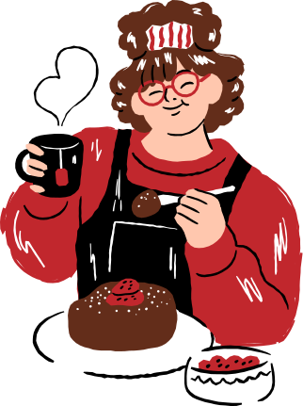
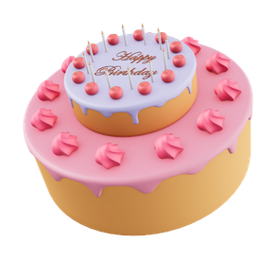
Colons & Clauses
Incorrect:
Sara is baking today, she is making a cake for her friend.
Correct:
Sara is baking today: she is making a cake for her friend.

Slide 11
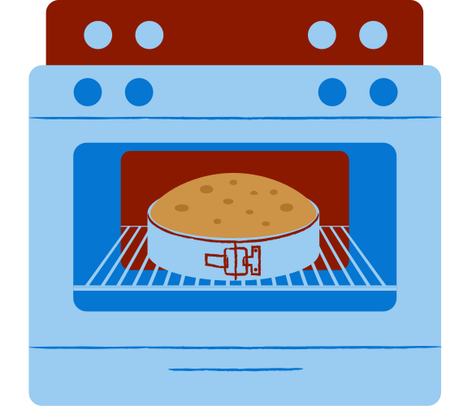
Colons & Lists
Incorrect:
A cake needs to have: flour, sugar, and eggs.
Correct:
A cake needs to have three ingredients: flour, sugar, and eggs.

